Slide 1


Dip in 5
Lesson 8
Association game

Slide 2
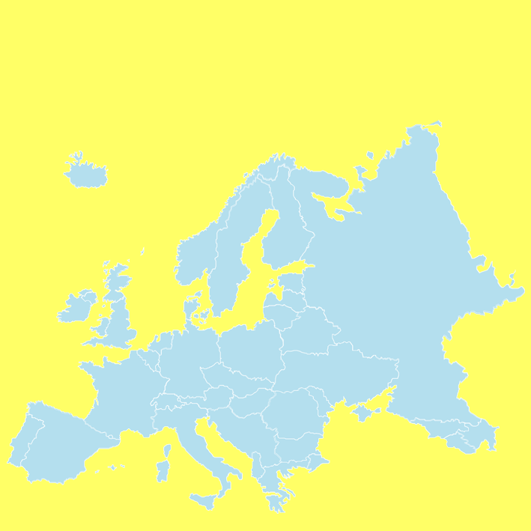
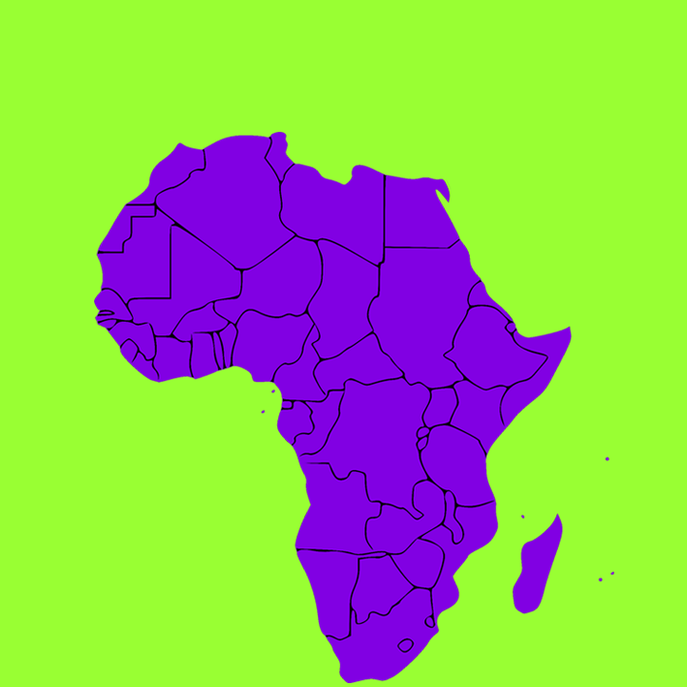
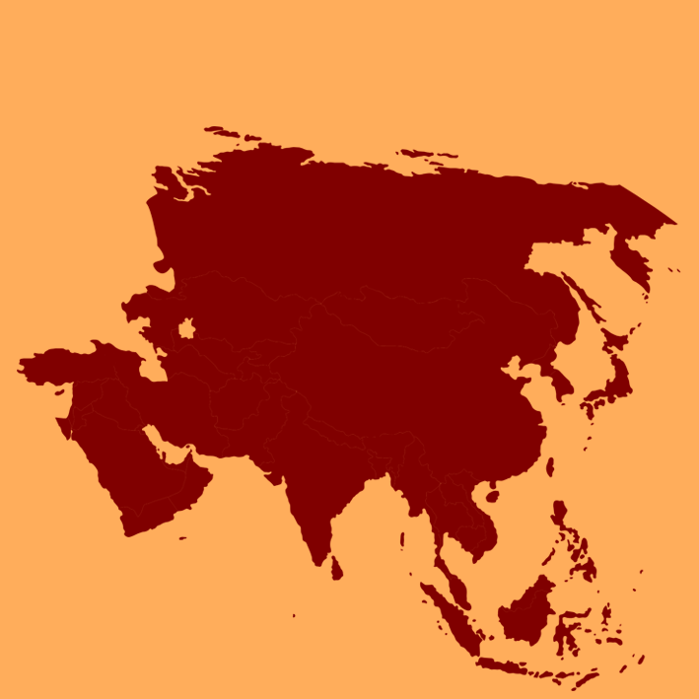
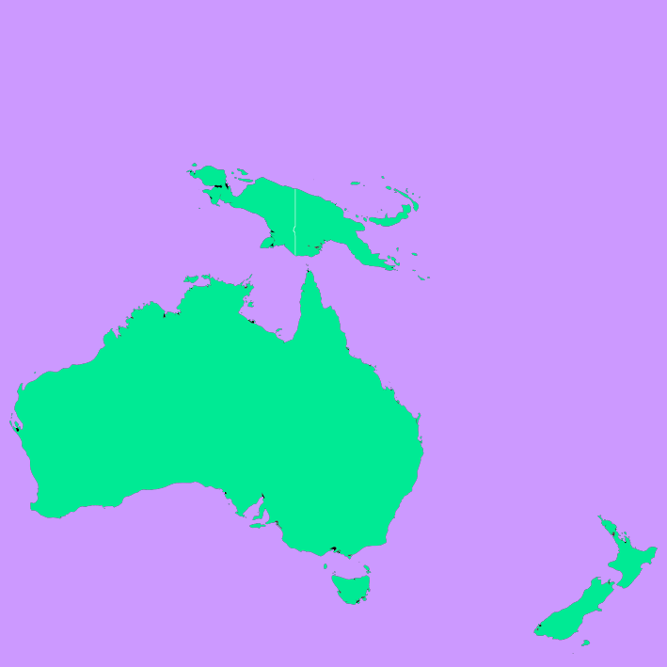

A1
the Eiffel Tower
B1
the Nile
C1
the Giant Panda
D1
didgeridoo
Dubrovnik
giraffes
Bengal Tiger
A2
B2
C2
D2
Down Under
the Baltic Sea
the Sahara Desert
the Great Wall
koalas
A3
B3
C3
D3
A4
the Alps
B4
lions
C4
the Himalayas
kangaroos
D4
COLUMN A
COLUMN C
EUROPE
COLUMN B
ASIA
AFRICA
AUSTRALIA
COLUMN D
THE FINAL ANSWER
PLANET EARTH

